Slide 1

Weekly Task
HTML, CSS & Responsive Website

Slide 2
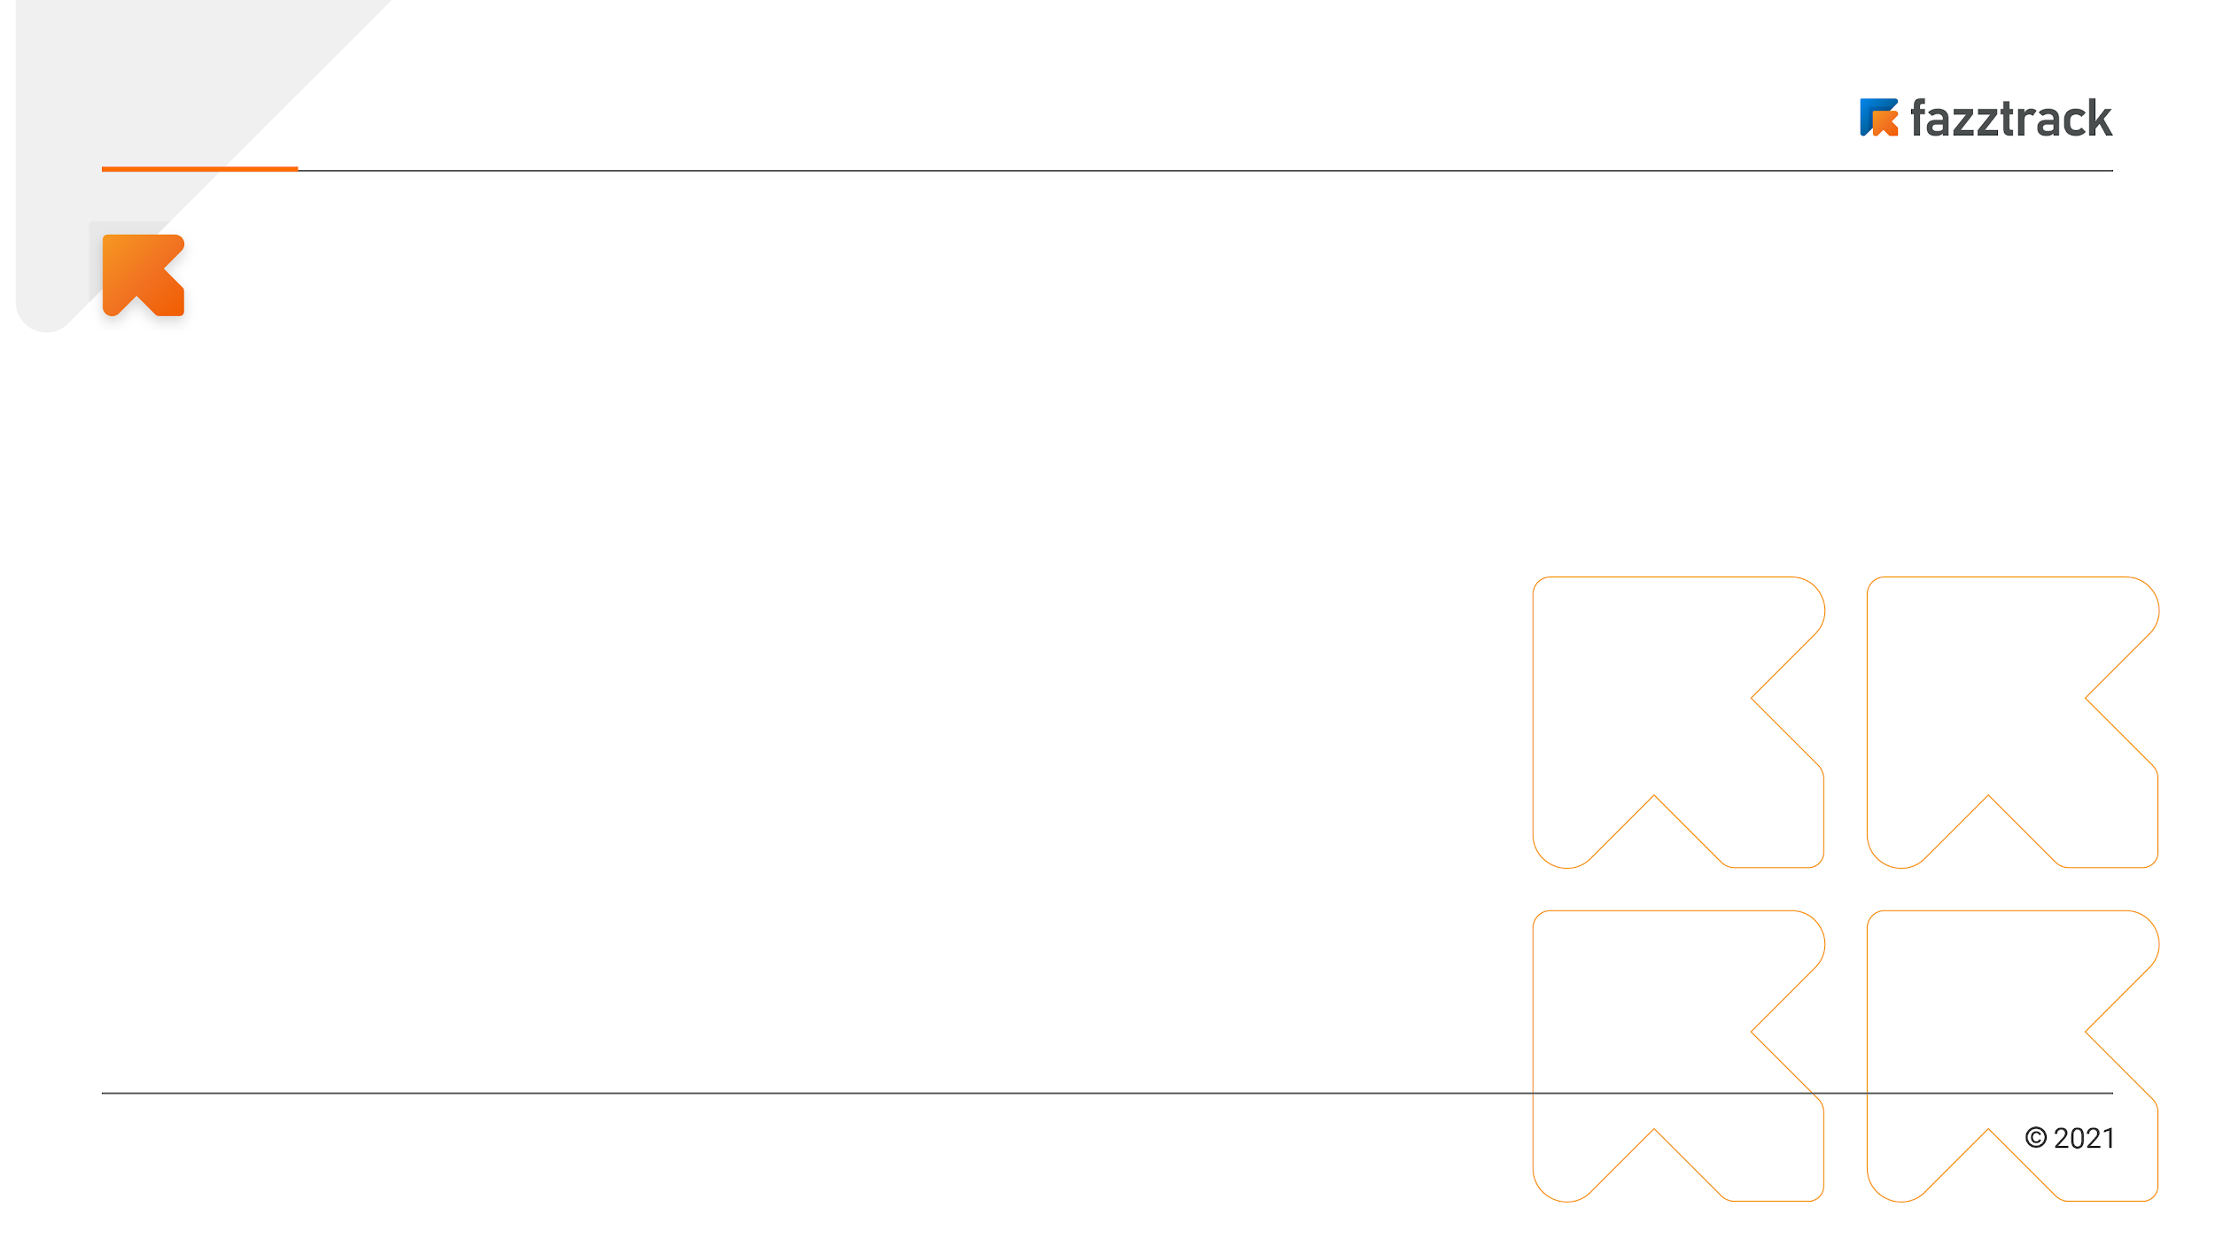
Weekly Task
There are several things we need to know when create a web page:
HTML
HTML or HyperText Markup Language, provides a set of tags or elements that define the structure and layout of a web page such as headings, paragraphs, images, forms etc.
CSS
CSS or Cascading Style Sheets that applied in conjunction with HTML and used for styling and layouting a web page and to create visually appealing and responsive web design.
Responsive Web
An approach to web development to build websites that adapt and respond well across a wide range of devices and screen sizes, like desktops, laptops, tablets, and smartphones.
Backend devops

Slide 3
Demo Project

